Slide 1

Algebra 1
Unit 9, Lesson 5 Solving Quadratics Using Square Roots Volume 2, pg. 81

Slide 2


Benchmarks
MA.912.AR.3.1
Given a mathematical or real-world context, write and solve one-variable quadratic equations over the real number system.
MA.912.AR.9.6
Given a real-world context, represent constraints as systems of linear equations or inequalities. Interpret solutions to problems as viable or non-viable options.
volume 2, pg. 81

Slide 3
Integrated Mathematical Thinking and Reasoning Standards
MA.K12.MTR.2.1 Demonstrate understanding by representing problems in multiple ways.
MA.K12.MTR.3.1 Complete tasks with mathematical fluency.
MA.K12.MTR.4.1 Engage in discussions that reflect on the mathematical thinking of self and others.
MA.K12.MTR.6.1 Assess the reasonableness of solutions.
volume 2, pg. 81

Slide 4

Learning Targets
I can solve a quadratic by taking the square root.
I can determine if a solution to a quadratic is non-real.
I can interpret solutions to quadratics given in a real-world context as viable or nonviable.
volume 2, pg. 81

Slide 5

Warm-Up
volume 2, pg. 82

Slide 6
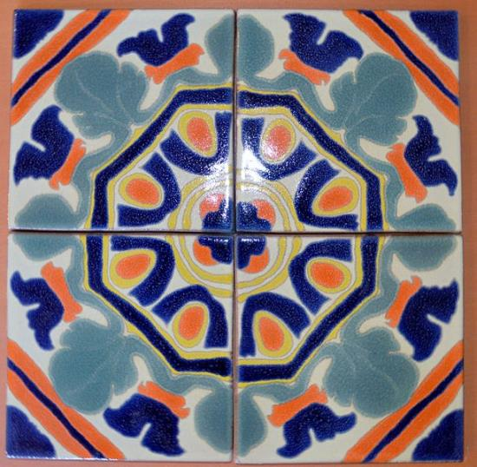
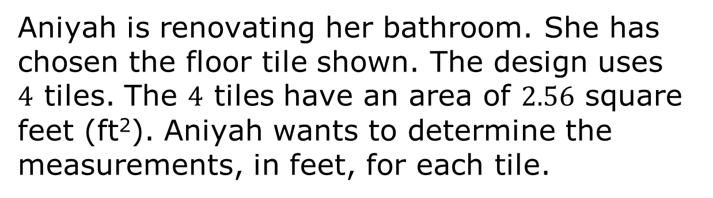
9.5.1 Warm-Up: Floor Tiles
Aniyah is renovating her bathroom. She has chosen the floor tile shown. The design uses $4$ tiles. The $4$ tiles have an area of $2.56$ square feet (ft²). Aniyah wants to determine the measurements, in feet, for each tile.
volume 2, pg. 82
Notes:
Video Link: https://algebranation.wistia.com/medias/fi4fidi5y8

Slide 7
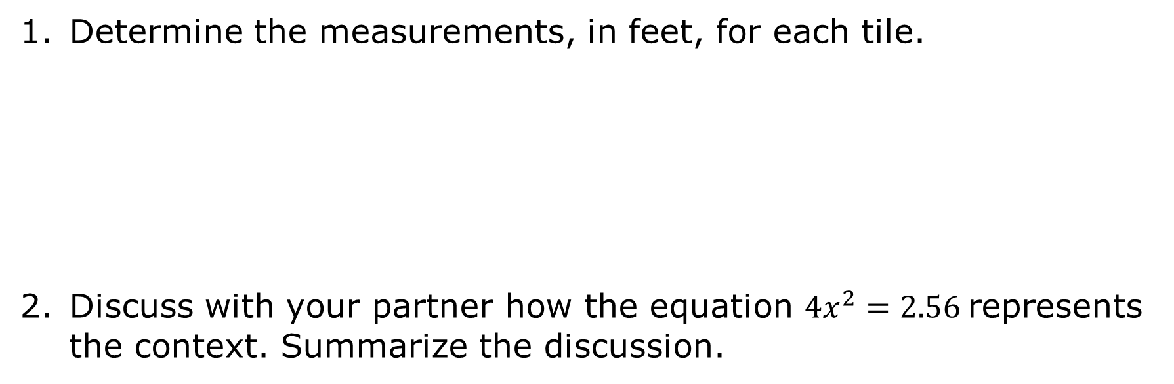
Determine the measurements, in feet, for each tile.
Discuss with your partner how the equation $4x^{2}=2.56$represents the context. Summarize the discussion.
volume 2, pg. 82

Slide 8

Exploration
volume 2, pg. 82

Slide 9
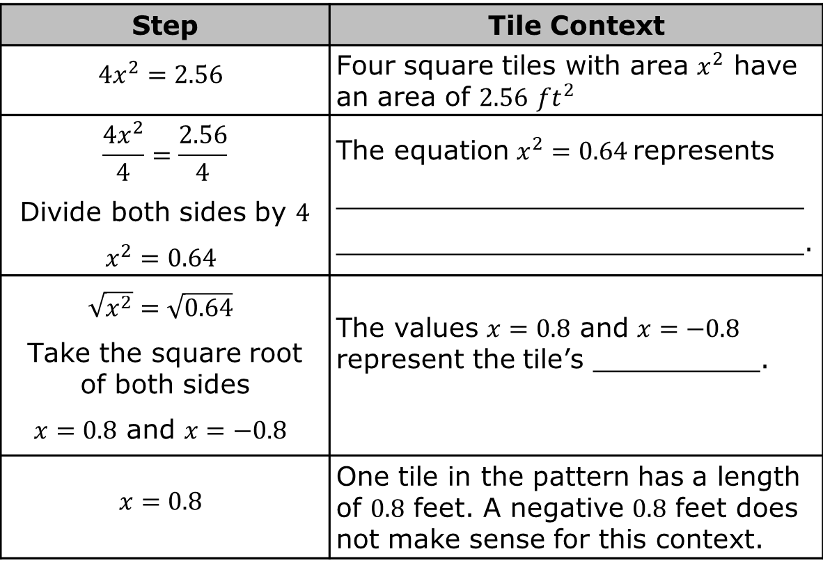
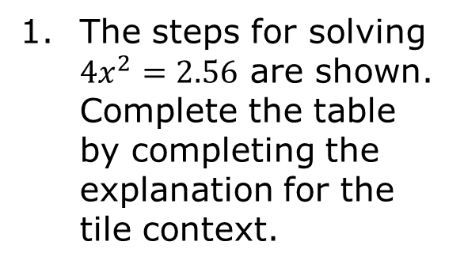
9.5.2 Exploration: Solving Quadratics Using Square Roots
The steps for solving $4x^{2}=2.56$ are shown. Complete the table by completing the explanation for the tile context.
Step | Tile Context
$$4x^{2}=2.56$$ | Four square tiles with area $x^{2}$ have an area of $2.56$ ${ft}^{2}$
$$\frac{4x^{2}}{4}=\frac{2.56}{4}$$ Divide both sides by $4$ $x^{2}=0.64$ | The equation $x^{2}=0.64$represents ____________________________ ____________________________.
$\sqrt{x^{2}}=\sqrt{0.64}$ Take the square root of both sides $x=0.8$ and $x=−0.8$ | The values $x=0.8$ and $x=−0.8$ represent the tile’s __________.
$$x=0.8$$ | One tile in the pattern has a length of $0.8$ feet. A negative $0.8$ feet does not make sense for this context.
volume 2, pg. 82

Slide 10
How do the steps in the table relate to the steps you used in the Warm-Up to determine the measurements, in feet, for each tile?
volume 2, pg. 82

Slide 11
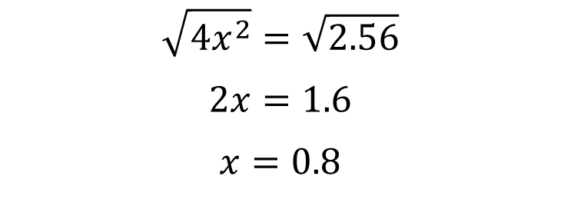

Wyatt wondered if he could solve $4x^{2}=2.56$ by first taking the square root of both sides. His work is shown.
Wyatt’s teacher told him that he could solve this quadratic by taking the square root of both sides first, but that he made a mistake in the second step of his work. Correct Wyatt’s work.
$$\sqrt{4x^{2}}=\sqrt{2.56}$$
$$2x=1.6$$
$$x=0.8$$
volume 2, pg. 83

Slide 12
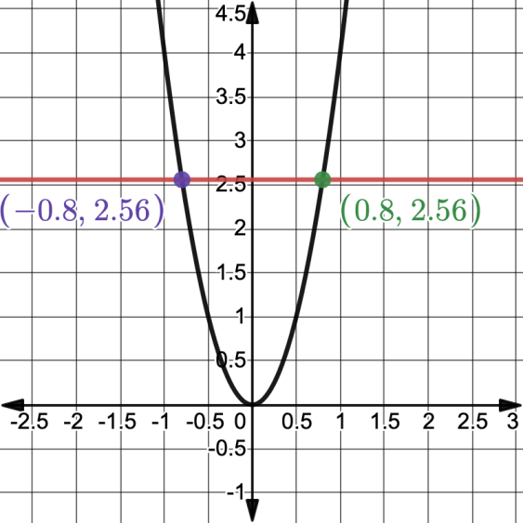

Dominic wanted to find the solution to $4x^{2}=2.56$ using a graphing tool. He graphed $y=4x^{2}$ and $y=2.56$. His graph is shown.
Discuss with your partner how the graph shows the solutions to $4x^{2}=2.56$. Summarize your discussion.
volume 2, pg. 83

Slide 13
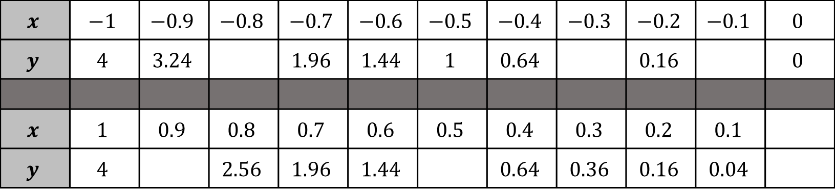

Takeisha created a table of values for $y=4x^{2}$.
Work with your partner to find the missing values in the table.
$$x$$ | $$−1$$ | $$−0.9$$ | $$−0.8$$ | $$−0.7$$ | $$−0.6$$ | $$−0.5$$ | $$−0.4$$ | $$−0.3$$ | $$−0.2$$ | $$−0.1$$ | $$0$$
$$y$$ | $$4$$ | $$3.24$$ |  | $$1.96$$ | $$1.44$$ | $$1$$ | $$0.64$$ |  | $$0.16$$ |  | $$0$$
$$x$$ | $$1$$ | $$0.9$$ | $$0.8$$ | $$0.7$$ | $$0.6$$ | $$0.5$$ | $$0.4$$ | $$0.3$$ | $$0.2$$ | $$0.1$$
$$y$$ | $$4$$ |  | $$2.56$$ | $$1.96$$ | $$1.44$$ |  | $$0.64$$ | $$0.36$$ | $$0.16$$ | $$0.04$$
volume 2, pg. 84

Slide 14
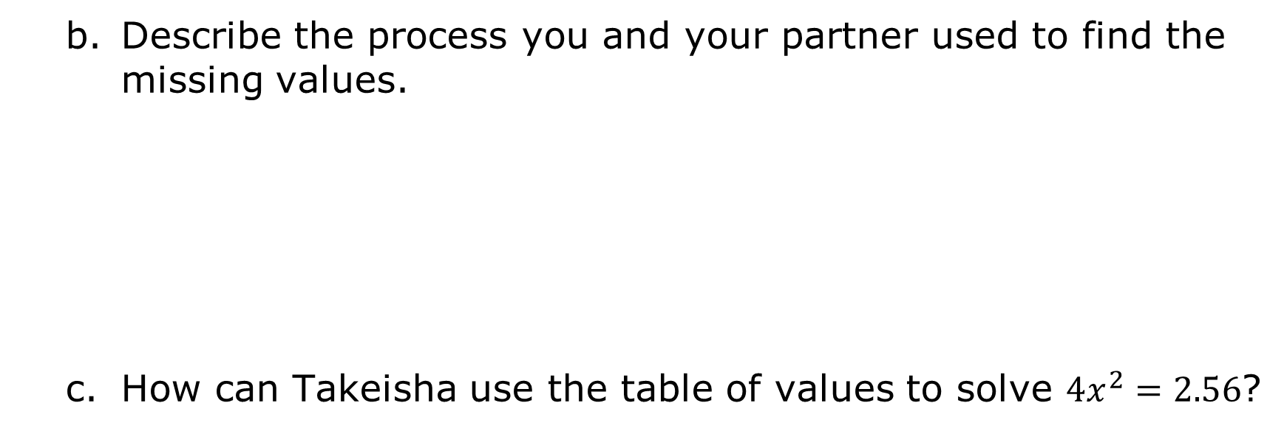
Describe the process you and your partner used to find the missing values.
How can Takeisha use the table of values to solve $4x^{2}=2.56$?
volume 2, pg. 84

Slide 15
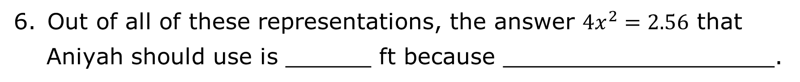
Out of all of these representations, the answer $4x^{2}=2.56$ that
Aniyah should use is ______ ft because ___________________.
volume 2, pg. 84

Slide 16

Guided Instruction
volume 2, pg. 84

Slide 17

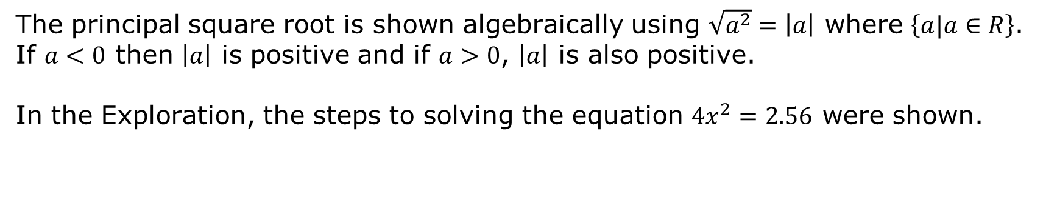
9.5.3 Guided Instruction: Solving Quadratics by Taking the Square Root
The square root of a number is the value that, when multiplied by itself, results in the radicand. For example, $\sqrt{25}$is $5$ or $−5$.
The principal square root is the positive square root of a positive real number.
The principal square root is shown algebraically using $\sqrt{a^{2}}=\left|a\right|$ where $\left\{a|a∈R\right\}$. If $a<0$ then $\left|a\right|$ is positive and if $a>0$, $\left|a\right|$ is also positive.
In the Exploration, the steps to solving the equation $4x^{2}=2.56$ were shown.
volume 2, pg. 84

Slide 18
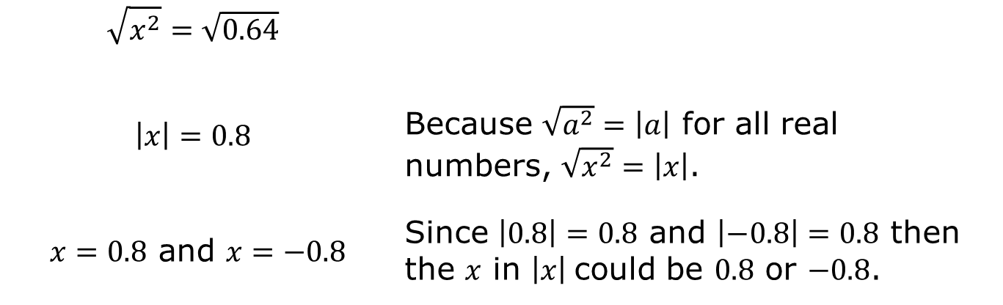
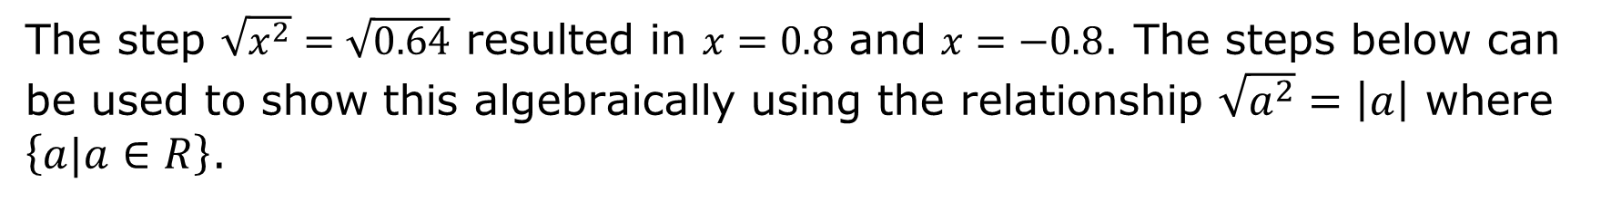
The step $\sqrt{x^{2}}=\sqrt{0.64}$ resulted in $x=0.8$ and $x=−0.8$. The steps below can be used to show this algebraically using the relationship $\sqrt{a^{2}}=\left|a\right|$ where $\left\{a|a∈R\right\}$.
$$\sqrt{x^{2}}=\sqrt{0.64}$$
$$\left|x\right|=0.8$$ | Because $\sqrt{a^{2}}=\left|a\right|$ for all real numbers, $\sqrt{x^{2}}=\left|x\right|$.
$x=0.8$ and $x=−0.8$ | Since $\left|0.8\right|=0.8$ and $\left|−0.8\right|=0.8$ then the $x$ in $\left|x\right|$could be $0.8$ or $−0.8$.
volume 2, pg. 84

Slide 19
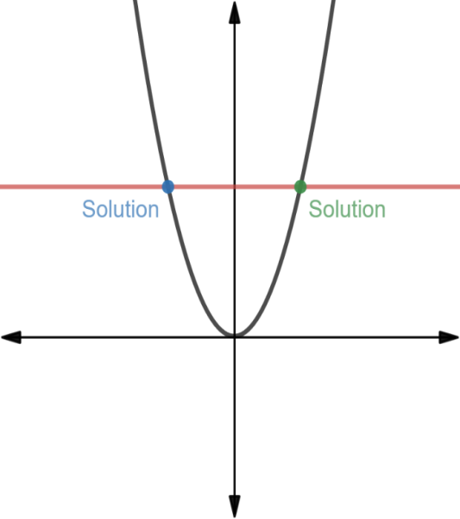
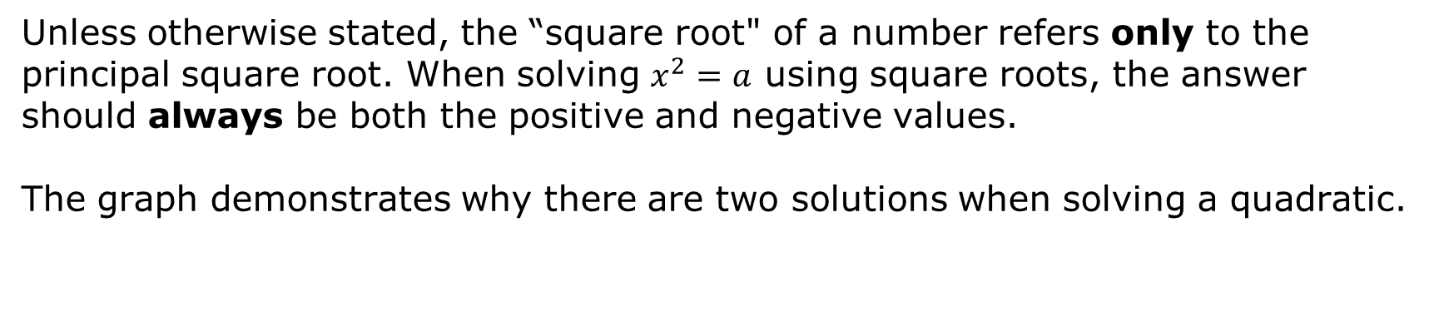
Unless otherwise stated, the “square root" of a number refers only to the principal square root. When solving $x^{2}=a$ using square roots, the answer should always be both the positive and negative values.
The graph demonstrates why there are two solutions when solving a quadratic.
volume 2, pg. 85

Slide 20
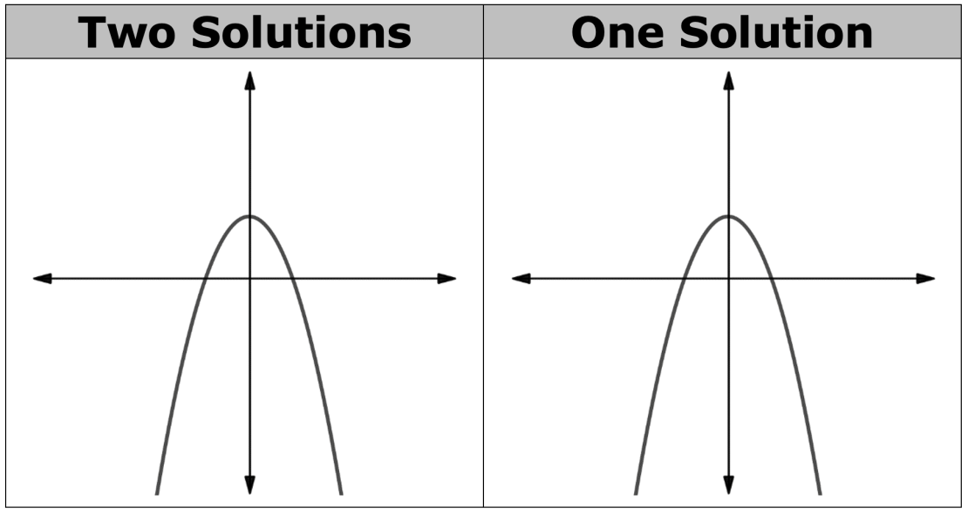
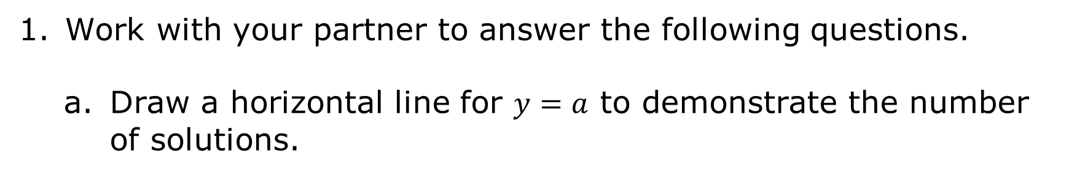
Work with your partner to answer the following questions.
Draw a horizontal line for $y=a$ to demonstrate the number of solutions.
volume 2, pg. 85

Slide 21
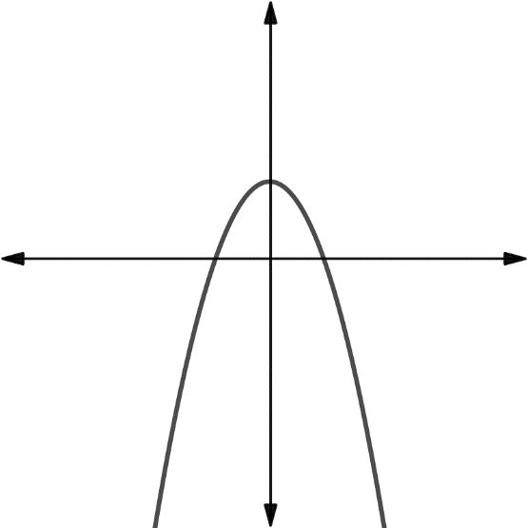
Describe where the horizontal line intersects with the parabola when the quadratic has one solution.
Discuss with your partner where a horizontal line could be drawn so that it does not intersect with the parabola. Demonstrate this by drawing a horizontal line.
volume 2, pg. 85

Slide 22
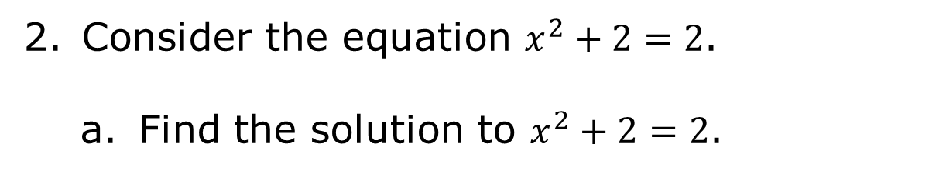
Consider the equation $x^{2}+2=2$.
Find the solution to $x^{2}+2=2$.
volume 2, pg. 85

Slide 23
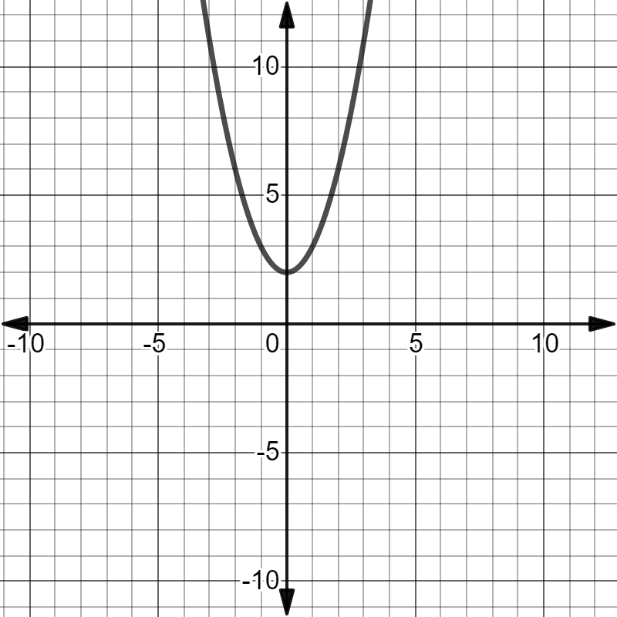
The graph of $y=x^{2}+2$ is shown. Draw a horizontal line that shows $y=2$.
Explain how the location of the intersection of the horizontal line and the parabola shows that $x^{2}+2=2$ only has one solution.
volume 2, pg. 86

Slide 24
The graph of$y=x^{2}+2$ is shown.
volume 2, pg. 86

Slide 25

Draw the horizontal line $y=−7$.
Find the solution to $x^{2}+2=−7$.
volume 2, pg. 86

Slide 26
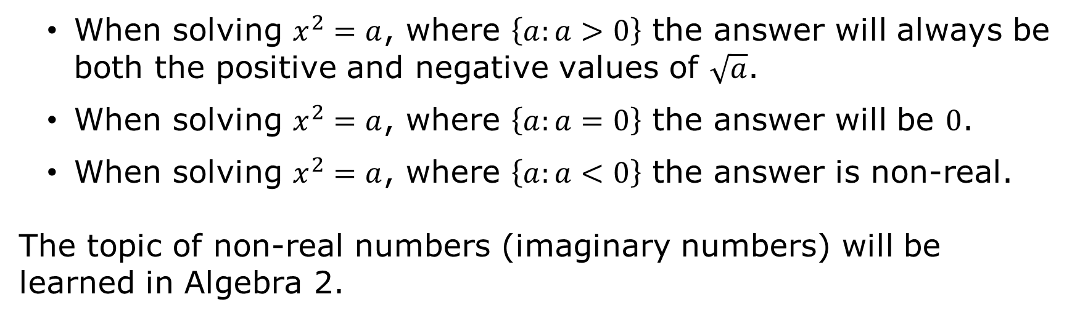
When solving $x^{2}=a$, where $\left\{a:a>0\right\}$ the answer will always be both the positive and negative values of $\sqrt{a}$.
When solving $x^{2}=a$, where $\left\{a:a=0\right\}$ the answer will be $0$.
When solving $x^{2}=a$, where $\left\{a:a<0\right\}$ the answer is non-real.
The topic of non-real numbers (imaginary numbers) will be learned in Algebra 2.
volume 2, pg. 87

Slide 27

Guided Practice
volume 2, pg. 87

Slide 28

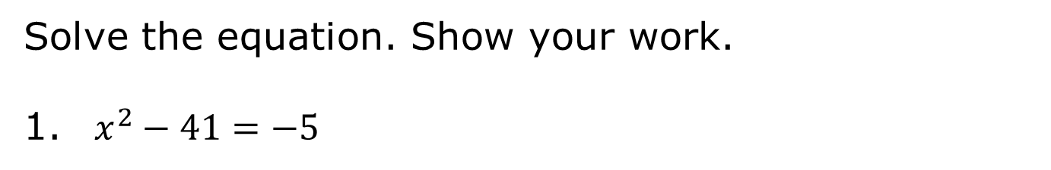
9.5.4 Guided Practice: Solving Quadratics by Taking the Square Root
Solve the equation. Show your work.
$x^{2}−41=−5$
volume 2, pg. 87

Slide 29

Try It
volume 2, pg. 87

Slide 30

9.5.5 Try It: Solving Quadratics by Taking the Square Root
Solve each equation. Show your work.
$−5x^{2}=−180$
$39=3\left(x^{2}+7\right)$
volume 2, pg. 87

Slide 31

Wrap-Up
volume 2, pg. 88

Slide 32
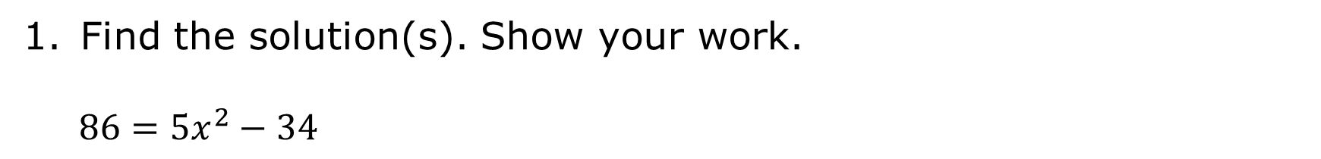
9.5.6 Wrap-Up: Ticket Out the Door
Find the solution(s). Show your work.
$$86=5x^{2}−34$$
volume 2, pg. 88

